Slide 1



Communicating Climate Change to Citizens
This presentation is aimed to sensitize the citizens of the MMR across various facets of climate change. It contains basic information on climate change, its impacts on MMR and their citizens, and actions that citizens can take in their daily lives to manage and counter climate change.
The presentation is part of the series Climate Change related Resources and Tools (CCRT).
Conceived and Developed by :
Environmental Management Centre LLP for Mumbai Metropolitan Region – Environment Improvement Society

Slide 2






Communicating Climate Change to Citizens
Prepared By: Environmental Management Centre_{LLP}

Slide 3
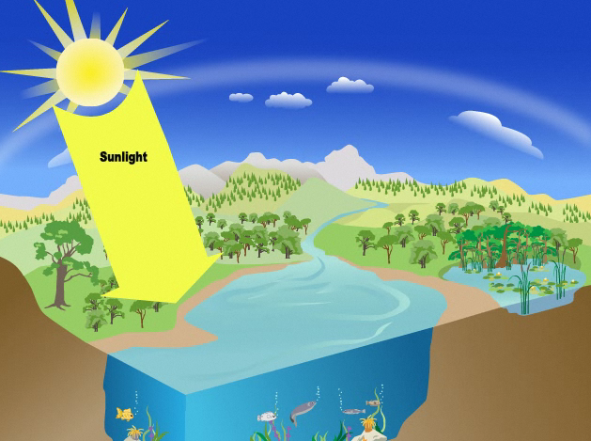

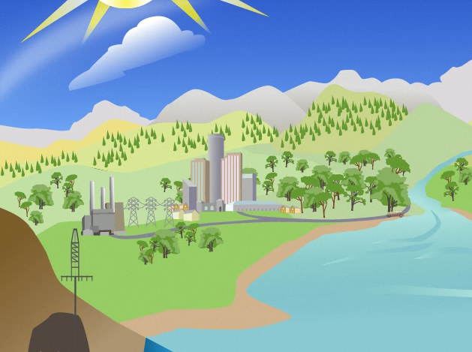
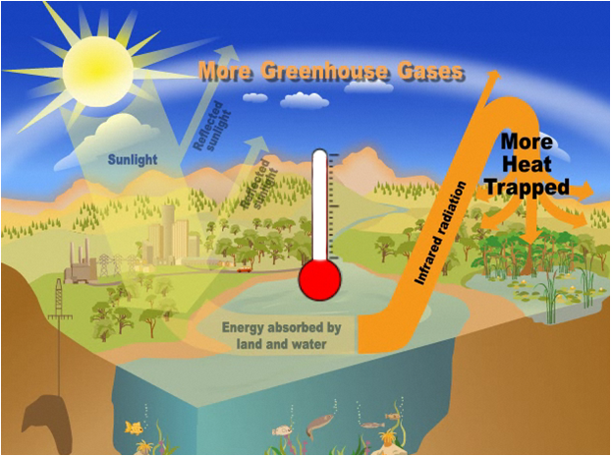
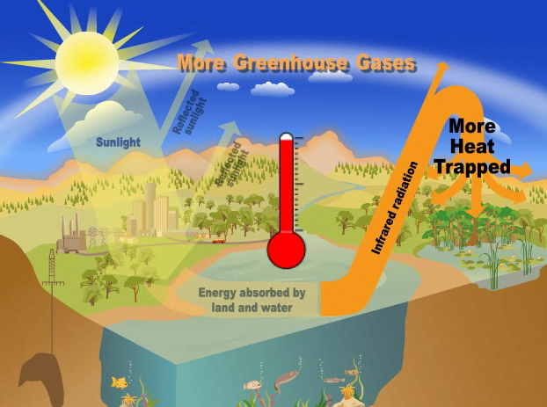
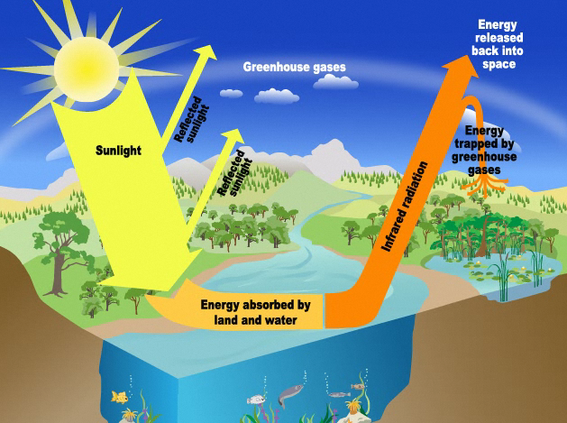
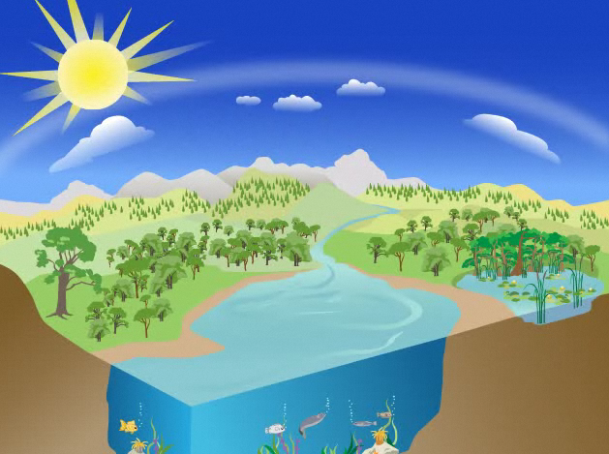


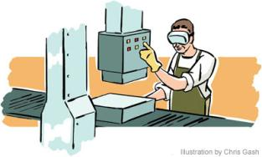

What is Global Warming?
What are greenhouse gases?
Gases that contribute to the greenhouse effect by absorbing infrared radiation, e.g. carbon dioxide, Methane, Nitrous oxide
Earth requires greenhouse gases so that living beings can survive
We add more greenhouse gases every day
When we use electricity
How are they generated?
BUT
Temperature
Increases
Leading to
When we drive our cars
When we Make a product in a factory
Global warming
Source: http://www.epa.gov/climatechange/kids/basics/today/greenhouse-effect.html
Notes:
The atmosphere has a natural supply of "greenhouse gases." They capture heat and keep the surface of the Earth warm enough for us to live on. Without the greenhouse effect, the planet would be an uninhabitable, frozen wasteland.
Before the Industrial Revolution, the amount of carbon dioxide (CO₂) and other greenhouse gases released into the atmosphere was in a rough balance with what was absorbed in natural sinks. For example, plants take in CO₂ when they grow in spring and summer, and release it back to the atmosphere when they decay and die in fall and winter.
Industry took off in the mid-1700s, and people started emitting large amounts of greenhouse gases. Fossil fuels were burned more and more to run our cars, trucks, factories, planes and power plants, adding to the natural supply of greenhouse gases. The gases—which can stay in the atmosphere for centuries—are building up in the Earth’s atmosphere and, in effect, creating an extra-thick heat blanket around the Earth.
The result is that the globe has heated up by about one degree Fahrenheit over the past century—and it has heated up more intensely over the past two decades.
Today, people have increased by nearly 40 percent the amount of CO₂, the chief global warming pollutant, compared to pre-industrial levels

Slide 4











Impacts of Global Warming
Extinction and loss of biodiversity
Spread of diseases
Change in Seasons
Droughts and wild fires in some places
Increased evaporation
Global warming
Melting of glaciers,
snow caps
Increased Rains in some places
Coastal area loss
Warmer Oceans
Increased storms
Sea Level Rise
Adapted from: http://epa.gov/climatechange/kids/basics/concepts.html
Notes:
Rising global temperatures lead to other changes , such as stronger hurricanes, melting glaciers, and the loss of wildlife habitats. That's because the Earth's air, water, and land are all related to one another and to the climate. This means a change in one place can lead to other changes somewhere else. For example, when air temperatures rise, the oceans absorb more heat from the atmosphere and become warmer. Warmer oceans, in turn, can cause stronger storms.
Since the 1970s, droughts have become longer and more extreme worldwide, particularly in the tropics and subtropics.
As temperatures rise and the air becomes warmer, more moisture evaporates from land and water into the atmosphere. More moisture in the air generally means we can expect more rain and snow (called precipitation) and more heavy downpours. But this extra precipitation is not spread evenly around the globe, and some places might actually get less precipitation than they used to get. That's because climate change causes shifts in air and ocean currents, which can change weather patterns
Hurricanes and other tropical storms get their energy from warm ocean water. As the top layer of the ocean gets warmer, hurricanes and other tropical storms grow stronger, with faster winds and heavier rain. Because of higher temperatures and increased evaporation, climate change causes other types of storms to get stronger, too.
As water gets warmer, it takes up more space. Each drop of water only expands by a little bit, but when you multiply this expansion over the entire depth of the ocean, it all adds up and causes sea level to rise. Sea level is also rising because melting glaciers and ice sheets are adding more water to the oceans.

Slide 5
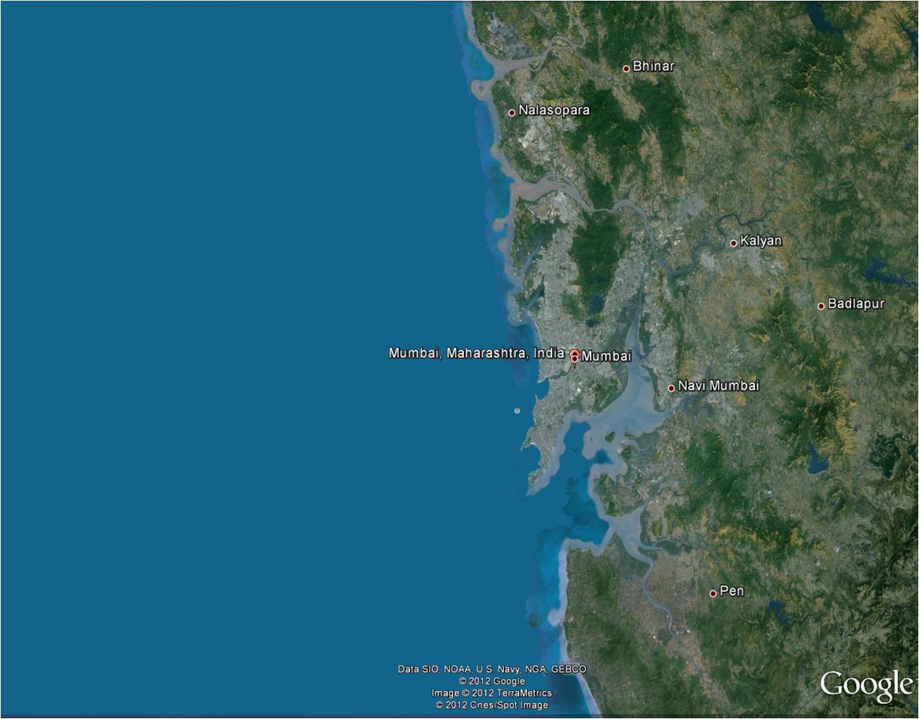
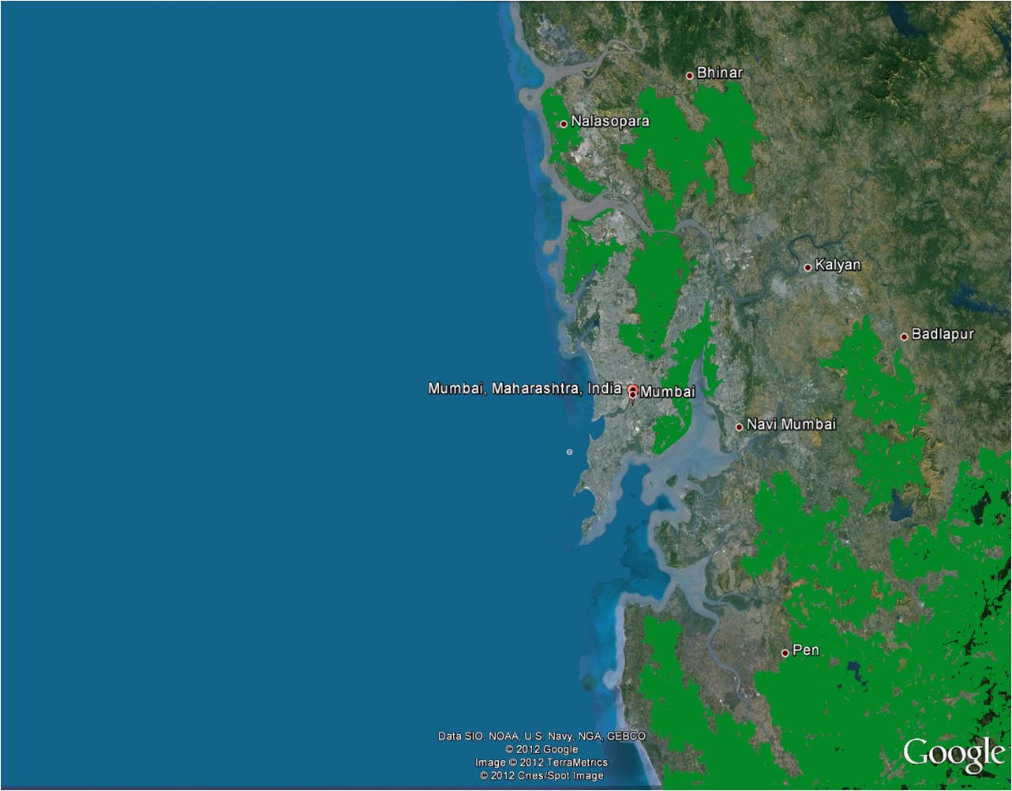
How will it affect us?
Long coastline – So more areas can be affected by storms, sea level rise and submergence
Many low lying areas can be affected by flooding of rivers and flash flooding due to extreme rainfall.
Water logging – increase in spread of diseases like malaria, dengue etc.
Less rainfall can affect agriculture and forests which provide us with food and timber.
Less rainfall also means less water for drinking, washing and bathing
Change in forests can affect birds and animals living in the forests
Notes:
This slide informs the citizens about how the impacts shown on the previous slide will affect the MMR and its surroundings.
As MMR has a long coastline with regions lower than the mean sea level. Thus with cyclones and stormy conditions these areas will be affected.
Also sea level rise, will cause the sea water to penetrate the ground water and make the foundations of building and infrastructure weak.
This region also receives huge amount of rainfall leading to water logging in low lying areas and flooding. Water logged areas are vulnerable to diseases like malaria and dengue. Also water borne diseases like cholera and jaundice can affect the communities.
As the climate will become uncertain, there are chances of the region receiving less rainfall than average. With such a huge population, the scarcity of water will affect the day to day lives of the citizens. Also agricultural production will decrease, leading to food security.
Extreme rainfall or drought like situations can affect all forms of life including plants, animals and birds. The food chain gets disturbed and as human beings are part of the food chain we will get affected too.

Slide 6
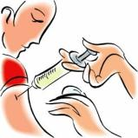


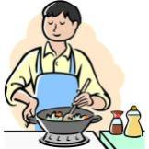
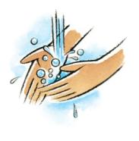

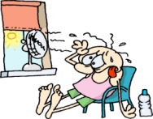
To Avoid-Take Action
HEALTH
Vaccinate yourself and spread awareness to your neighbors
Keep your surroundings clean
Do not let water log in your surroundings
Avoid eating outside, eat home made nutritious food
Wash your hands/ use sanitizer before eating
Drink plenty of water during summers
Do not move out at noon if heat waves are predicted
Notes:
This section is to informs the citizens that there will be an increase in the vector borne and water borne diseases,
And thus, it is advisable that they follow the above mentioned action to keep healthy.

Slide 7
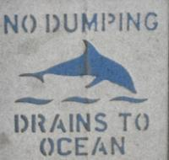
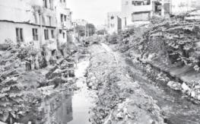

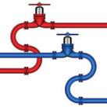
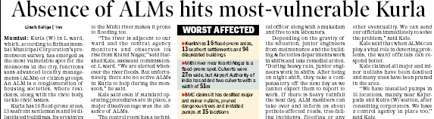
To Avoid-Take Action
FLOODING
Do not throw garbage in storm water drains
Do not block natural water run-off
Build houses on a higher plinth
Do not connect sewer lines with storm drains
ALMs and citizens group should work together to prepare the people for any adversity
Source: The Times of India , Mumbai edition, Pg. 4, 19th June, 2012
Notes:
MMR is vulnerable to flooding and thus they should be explained on how to adapt to them.
Also explain the ALM activities and how strong society actions can benefit them during a disaster.

Slide 8
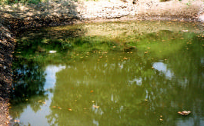
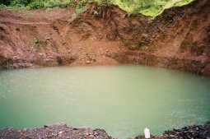
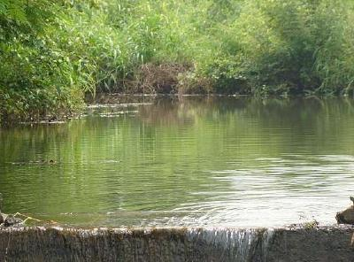
To Avoid-Take Action
DROUGHTS & WATER SCARCITY
Use water economically
Harvest rain water at individual and community level
Rural water harvesting by
Farm ponds
Check Dams
Tanks
40 flats, 200 residents in a congested area
10 minutes of municipal water supply
Bore well water used for flushing needs
Rain water harvesting system installed
Cost: Rs.25000/-
Water harvested: 13,500 liters/day
DOMBIVILI
Source: http://www.enviro-arch.com/article_harvesting_harnessing.html, accessed, 9th August,2012
Source: ACWADAM(2005), AGRAR Case study:Kolwan Vallet site, Pune District, Maharashtra, India, Pg. 5
www.slideshare.net/aminmohan/rotary-club-of-thane
Notes:
The urban areas of MMR are dependent on the nearby sources of water and thus conserving them and replenishing them should be of utmost importance.
This slide gives information on the harvesting means in urban and rural areas.

Slide 9
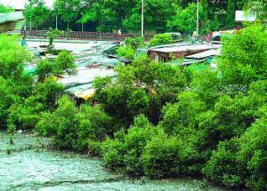
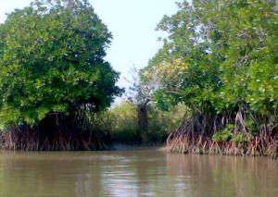
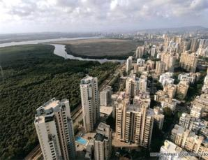
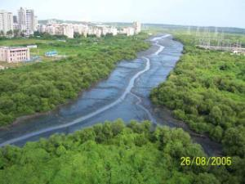
To Avoid-Take Action
FORESTS AND WILDLIFE
Do not cut trees in your neighborhood, preserve them
Plant more trees. They help to absorb water, give shade and purify the air
Protect the mangrove forests
As
They reduce the flood impact
They reduce effects of storms and tsunamis
They are home to many different birds, animals and fishes
70% of Mumbai Mangroves have been destroyed
Citizens (Like ‘Save Andheri Versova environment’)campaigned along with Conservation Action Trust to save the mangroves
BMC set up 16 local committees of citizens and officials to protect mangroves
Mumbai
Source: C AT(2010), Conservation Action trust Annual report 2008-2009, Mumbai
Notes:
This slide gives information on forest and their importance.
Also a special focus is on mangrove preservation as they are of great importance to the coastal areas.

Slide 10
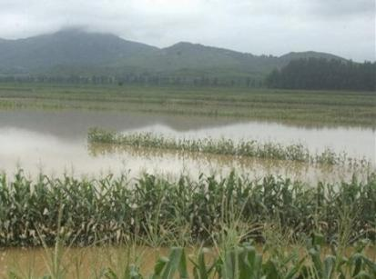
To Avoid-Take Action
INSURANCE
Insure your property against natural calamities
Climate insurance for agriculture
2011 - HDFC ERGO General Insurance distributed claim checks to farmers who faced losses due to heavy rainfall
Rs. 1000 per acre against Rs. 352 per acre premium
HDFC ERGO General Insurance started climate insurance in Maharashtra from 2012
BHOPAL
Source: http://www.indiaprwire.com/pressrelease/insurance/20111128104835.htm accessed 9th August, 2012
Notes:
One of the occupation in MMR is agriculture will also be affected due to climate change.
This slide gives information on insurance schemes that are available for agriculturists in Maharashtra.

Slide 11
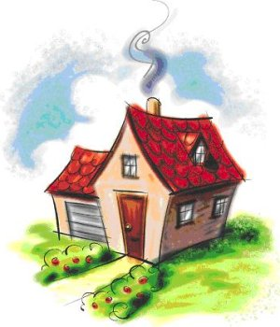
What can we do to reduce GHG emissions?
@HOME
Home cooling
Appliances
Water
Lighting
@HOME
TRANSPORT
FOOD
CONSUMPTION AND WASTE
Notes:
This slide and the slides below give the children an idea on how to reduce the ghg emissions.
Here emphasis is on small things which collectively can make a big difference.
The major point to highlight is that every one can help to reduce ghg and that they should share this information with their parents and neighbors.

Slide 12

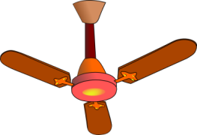
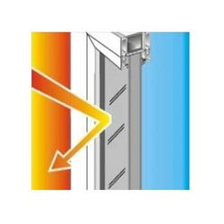


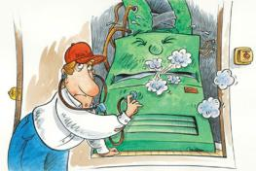
@ HOME
Home cooling
Set AC temperature to 25 ⁰C
Use fans instead of ACs
Install reflective window panes
Use curtains to block sunlight
Buy energy efficient fans and cooling system
Regular maintenance of cooling systems

Slide 13
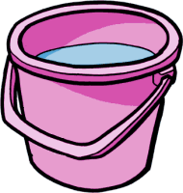
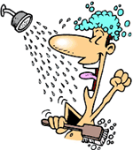
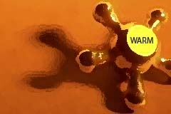
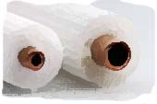
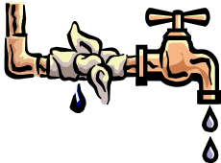

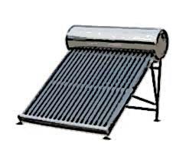
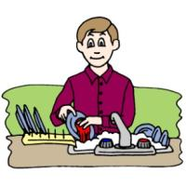
@HOME
Water
Use bucket instead of shower
Install low flow shower head
Use water at room temperature whenever possible
Insulate pipes
Check for leaks
Turn off tap when not in use
Install solar water heater
Do not wash utensils under running water

Slide 14
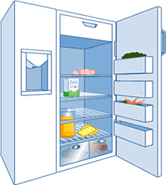
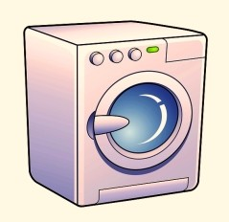
@HOME
Replace inefficient models
Appliances
Set temperature 3-5⁰C
Cool food before putting in the fridge
Check Gasket lining
Wash clothes in cold water
Run washer with full loads
Sort clothes by material for drying
Don’t overload the dryer
Dry clothes in sun whenever possible
Minimize detergent use

Slide 15
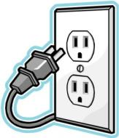
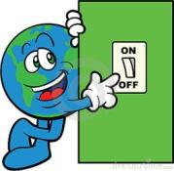


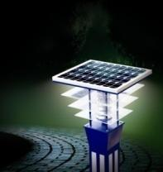
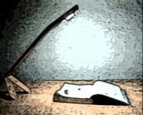
@ HOME
Lighting
Unplug devices when not in use
Switch off lights when not in use
Replace incandescent lamps with LEDs or florescent lamps
Use natural light during day time
Use motion sensors or solar lights for outdoors
Use focus lights instead of lighting the whole room

Slide 16




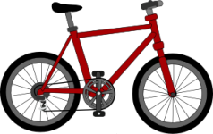
What can we do to reduce GHG emissions?
TRANSPORT
Kilometers Traveled
Vehicle maintenance
Efficient driving
Mode of Travel
@HOME
TRANSPORT
FOOD
CONSUMPTION AND WASTE

Slide 17


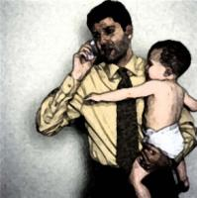
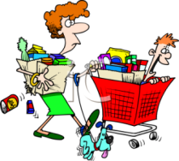

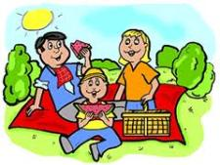
TRANSPORT
Kilometers traveled
Use public transport
Car-pool
Work from home when possible
Run errands less often (Buy groceries once a month)
Walk or cycle
Plan holidays closer to home

Slide 18

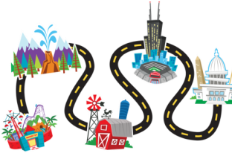

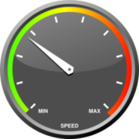
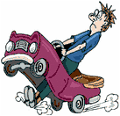

TRANSPORT
Fuel efficient driving
Warm up engine by driving
Plan your route
Travel light, remove roof racks
×
Maintain steady speed
Accelerate and brake steadily
Buy fuel efficient vehicles (Bharat III,IV; Euro III, IV, VI)

Slide 19
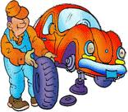


TRANSPORT
Vehicle maintenance
Check tire pressure regularly
Change air filters regularly
Keep engine tuned

Slide 20




What can we do to reduce GHG emissions?
FOOD
Food kilometers
Home grown food items
Efficient cooking
Processed food and meat
@HOME
TRANSPORT
FOOD
CONSUMPTION AND WASTE

Slide 21




FOOD
Buy locally grown food
Food Kilometers
Avoid Food products from foreign countries
Walk or cycle to buy food
Food
items
Use balconies and terraces to grow you own food
Buy fewer processed food items

Slide 22




FOOD
Efficient
cooking
Clean the stove burners regularly
Use pressure cookers or cook with lids on pans
Do not pre-heat oven more than 10 minutes
Thaw foods outside rather than using the microwave

Slide 23



What can we do to reduce GHG emissions?
CONSUMPTION AND WASTE
Reduce
Reuse
Recycle
Compost
@HOME
TRANSPORT
FOOD
CONSUMPTION AND WASTE

Slide 24









Consumption and Waste
×
Reduce
Reuse
Recycle
Buy only what you need
Repair broken items and reuse
Buy second-hand items if possible
Buy durable items
×
Avoid using disposable and packaged items
Reuse food containers
Use cloth bags for shopping
×
Reduce paper use, print only if needed
Recycle paper, plastic, aluminum cans, glass, electronics, light bulbs

Slide 25





Consumption and waste
Compost
Donate unwanted clothes, stationery, books & artifacts
Separate dry waste and wet waste
Use wet waste to prepare compost
Composting can be done at individual and community level
Compost can be used for gardening and
growing food at home

Slide 26






And Finally to Conclude…
Climate change will affect our daily lives
Precautions in terms of health, food and water are important
By using public transport, decreasing the consumption and waste, emissions can be reduced
By taking measures like rain water harvesting and keeping the drains clean, disasters can be evaded
Adopt traditional knowledge systems which are sustainable

Slide 27
And Finally to Conclude…
Actions of each and every individual matter
Altering your lifestyles can make a difference
Its we, who have changed the climate so we are responsible
Lets work together for a better future
“Earth provides enough to satisfy every man’s need, but not every man’s greed” – Mahatma Gandhi

Slide 28
The presentation is part of the series Climate Change related Resources and Tools (CCRT) developed to spread awareness on climate change and related issues as well as to facilitate actions to lessen the impact of climate change. As part of the series various other booklets, posters, factsheets, presentations, etc. have been created. The portal also has online carbon footprint calculators and a map on climate change related institutions.
To know about the other resources created under this series visit www.mmr-ccrt.org.in.
Conceived and Developed by :
Environmental Management Centre LLP for Mumbai Metropolitan Region – Environment Improvement Society

